Slide 1
Welcome to Duckling Class Parent Open Morning Thursday 10th January 2019
Introducing Planning in the Moment:
A child initiated approach to learning.

Slide 2
What is ‘in the moment’ planning?
Less forward planning or pre-planned activities.
Follows the interests of the child/children at all times.
Challenge and development happens on the spot whenever an occasion arises. This may last from a few seconds or over a period of time.
Notes:
Still plan a topic but this will change and evolve with the childrens’ interests.
Still plan for a phonics and maths carpet session. Still follow RWI.
Examples of moving learning on (i.e. scissor skills vs a personal interest project i.e. dinosaur habitats.)

Slide 3
What’s changed at Yaxham?
Focus children
Story scribing
An open-ended challenging environment
Timetable changes
Snack time
Outdoor and indoor play in all weathers
wellies / spare clothes / waterproofs
aprons
Notes:
Free-flow from 9am-11.30 (Open snack table between 9.30 & 11.30) – Break time optional depending on activity in class environment.
RWI 11.30-12.15
Maths carpet sessions 1.15-1.30
Free-flow 1.30-2.30
2.30 – Join the rest of the school for collective worship / Reward & Reflection time / Home time
Snack time – ‘open snack’ available between 9.30-11.30

Slide 4
What does this mean for my child?
More learning through play.
More time to be children.
Less expectations to sit at the table and repeat an activity.
More opportunities to explore through their imagination.
More opportunities to develop own sense of challenge and risk.
Notes:
Children learn the most through deep engagement in play. This is why we have structured our timetable to allow for optimal concentration in play. This is also why we dislike calling children out of their play to come and do an adult activity that they are unlikely to fully engage with.
We will be encouraging children to take risks in all elements of their play – whether that be physical, mental or personal challenges.

Slide 5
What does this mean for us as parents/carers?
Please keep reading!
Parent meetings vs Parents evening
Focus child sheets
Tapestry
Notes:
We do try to read with your children! The most important reading is done at home. Children will be reading all the time in their environment and around the classroom – without necessarily sitting in front of a reading book. Children will be assessed regularly through RWI.
Focus child meeting are proposed to take place instead of parents evenings. This is because the most up-to-date personalised information and discussion can take place whilst we have been deeply involved with your child’s learning.

Slide 6
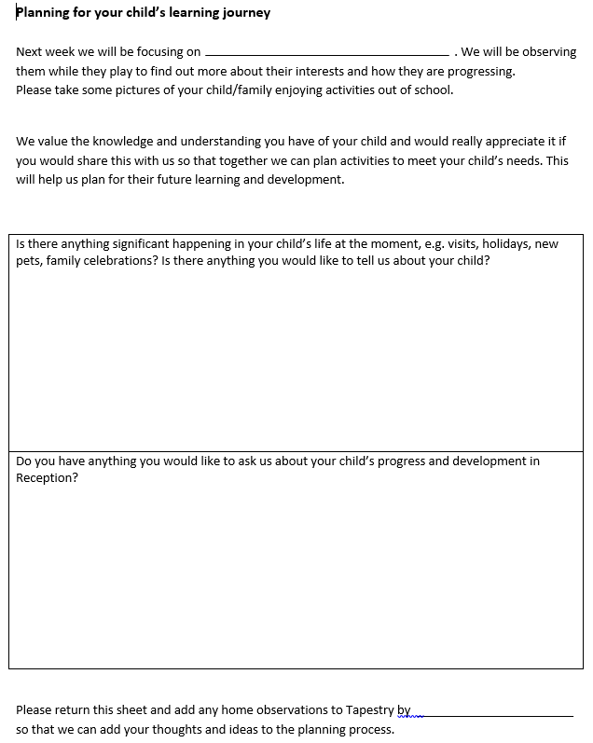

Slide 7
Pause for Thought
Anna Ephgrave coined the phrase ‘in the moment planning’ and introduced this in her school, Carterhatch. The Early Years was graded ‘Outstanding’ in 2013 and in the most recent 2018 OFSTED inspection.
https://www.youtube.com/watch?v=DupP16PTErc

Slide 8
What about Progress?
We will monitor our observations to make sure we are covering all areas of EYFS.
More focused, short interventions will be used if a child is struggling with something in particular.
We will be using children’s next steps and our knowledge of target areas to use this in our language during their play.
Children make more progress because they are fully engaged with their own learning.
Notes:
I am still using the Rainbow Challenges display that I created last half term. The changes I have made are that there is no longer a ‘specific’ challenge the children need to achieve. Once we have seen a child completing maths, writing, physical development etc in their own activity, a lollipop stick will be put into their cup to show that we have seen this happening.

Slide 9
Concluding comments
Continuing to develop and improve
Unfortunately it doesn’t come together overnight
Ongoing process
Questions and Concerns

